Slide 3
Drawing COMPETITION AT JAMUI CENTRE
“Logic will take you from A to B, creativity will take you everywhere”
-Albert Einstein

Slide 4
The best of all the wonders.....

Slide 5
HIGHLIGHTS
Sankalp organized a drawing competition at its Jamui Cenre, Laxmipur Bihar
Drawing Sheets and Wax Crayons were given to children for realizing their creative aspirations
Drawing Sheets were shared and children would be awarded after a proper evaluation.
The event takes place regularly where we intend to figure out talented students form the lot and impart them with necessary skills through appropriate training

Slide 6
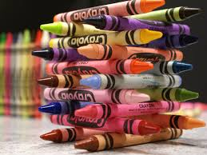

Slide 7
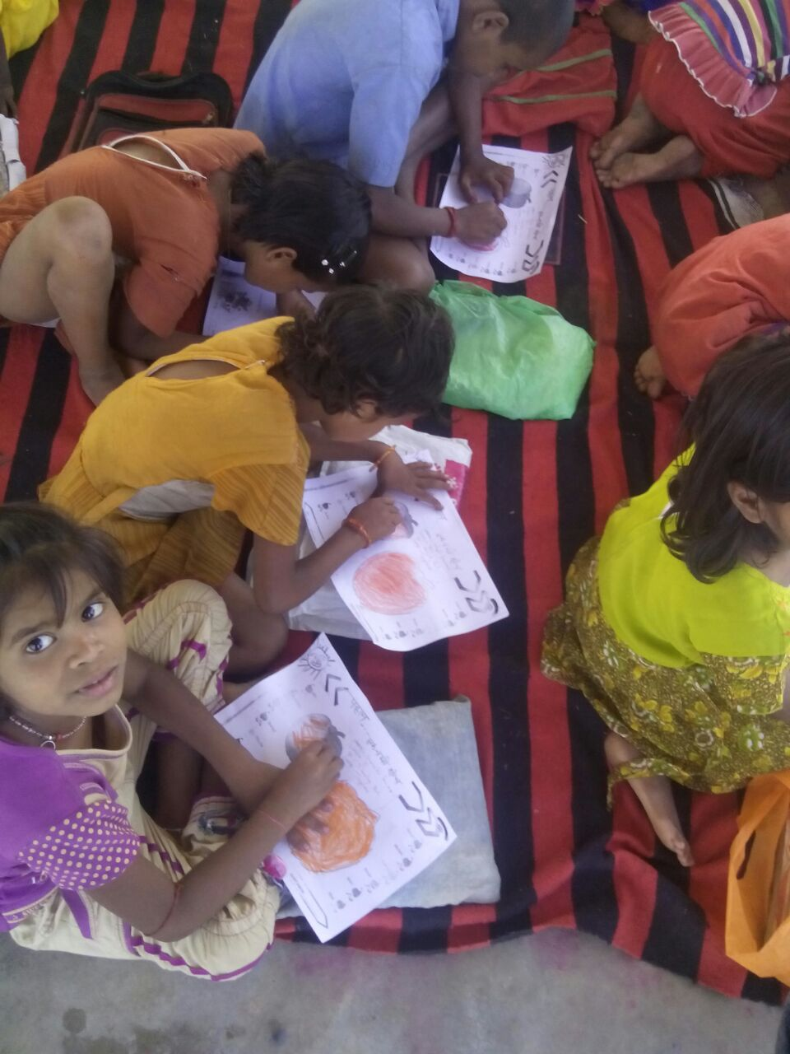

Slide 9
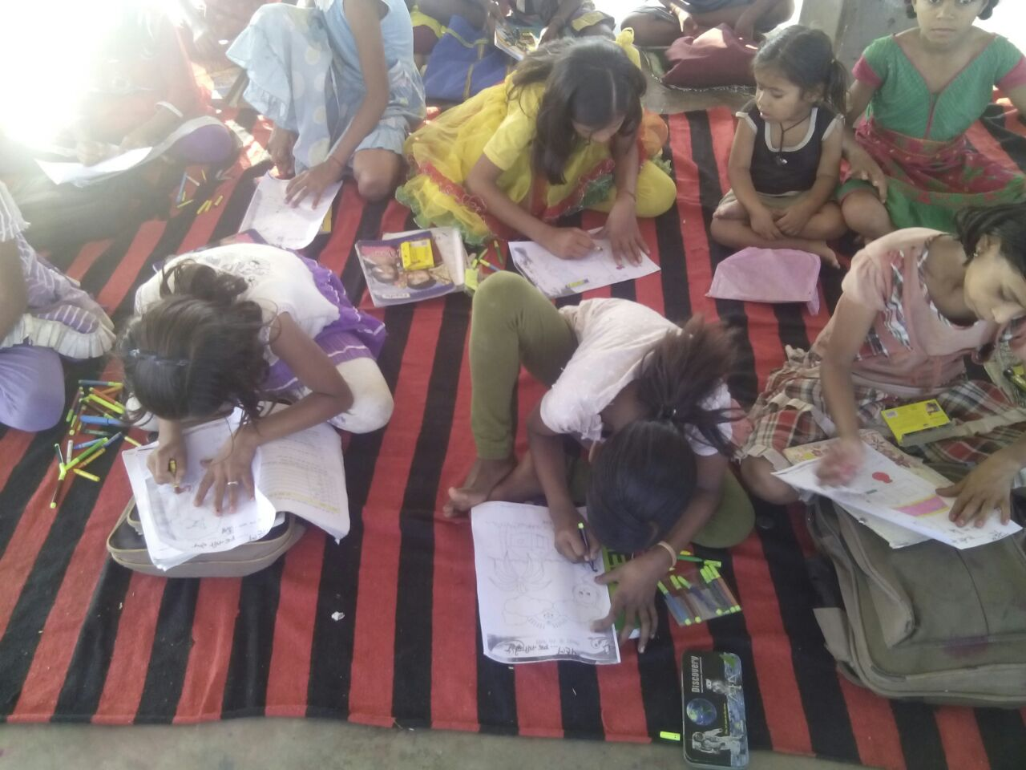

Slide 10
And this is all because we believe that.....

Slide 11
BE A PART OF THE JOURNEY
You can donate at any our centres by just making a call to Sankalp-A Pledge to Change volunteers.
All our centres run 6 days a week
You may donate books from
Class 1-8- Course Text Books (Any Board)
Story Books
Unused stationery
Any other items like bag, toys, uniforms etc.
Relevant Contact Nos. Are
Subodh Kumar Das-9798756336
Mayank Aggarwal -9031975746
Suresh Pareek -7209632032
Vikas Dixit -9472706225

Slide 12
ACCOUNT DETAILS FOR SUPPORT
Sankalp Account Details
You can transfer funds online into our account:-
“SANKALP” A/C No.-31114719936
CIF No: 85757412911
IFSC Code: SBIN0001882
MICR Code: 831002004
Branch code: (1882)
Branch: SBI- RIT JAMSHEDPUR
You may also visit our website and pay through online link available over it.
www.sankalpnitjamshedpur.org

Slide 13
“You have not lived today until you have done something for someone who can never repay you.”
Thank You
www.sankalpnitjamshedpur.org

